Slide 1
Overview Master’s Thesis
Automated Steering Measurement
Julian Bogenberger 06.11.2023

Slide 2
Overview Past
What has been done?
Sensor Evaluation
External Camera Implementation
Template Matching
Edge Detection
Colored markers for measurement on steering
Neuronal Network training
YoloV8 detection
YoloV8 semantic segmentation
Angle measurement in 2D

Slide 3
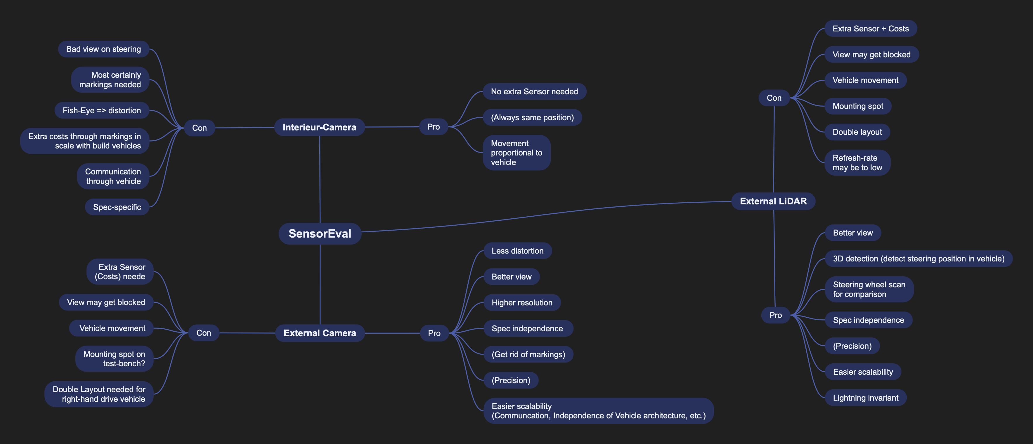
Overview Past
Sensor Evaluation

Slide 4
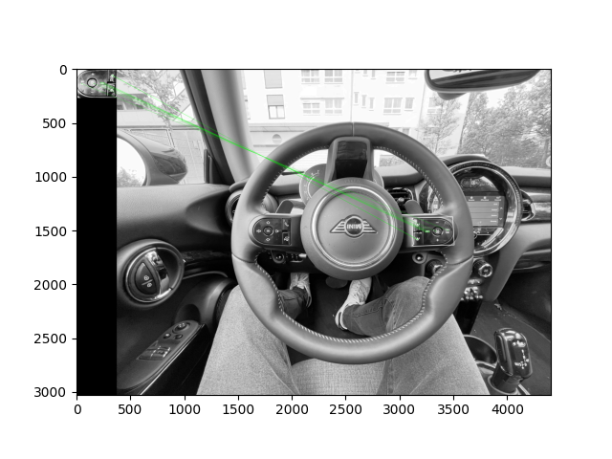
Overview Past
Template Matching
Give system template of features of steering
Scan image for templates
Find enough features to ensure steering position

Slide 5
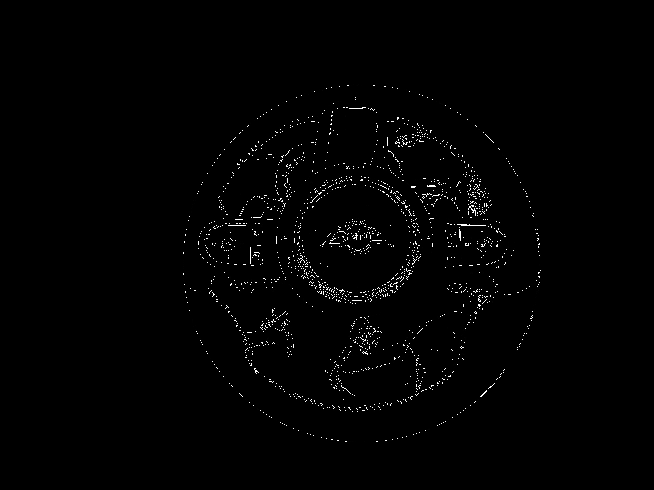
Overview Past
Edge Detection
Detect edges in image
Look for features that certain steering is always showing
No measurement so far

Slide 6
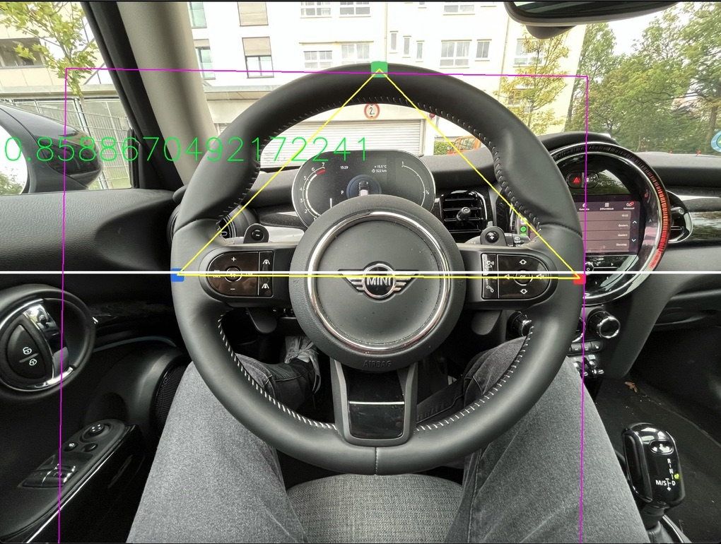
Overview Past
Colored markers on steering
Add markers to steering on 9, 12 and 3 o’clock
Find every mark and connect them
Measure angle (currently only in 2D image plane)
White line represents 0°
Number represents angle of steering

Slide 7
Overview Past
Neuronal network training
YoloV8 does not support steering wheel class out of the box
Custom training needed
Training for detection task with public dataset
Training for semantic segmentation tasks with custom dataset (Very little dataset)

Slide 8
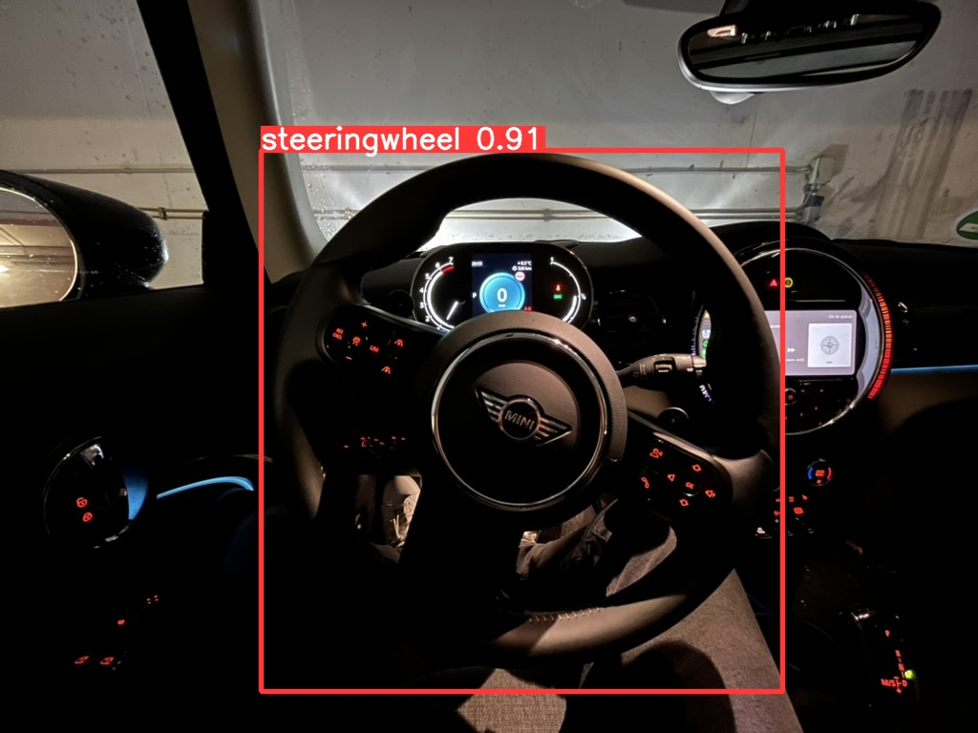
Overview Past
Yolo Detection
Detection results in 2D bounding box
Nearly no use for measurements
But representable for class learning
Confidence Score and detection under non-optimal conditions

Slide 9
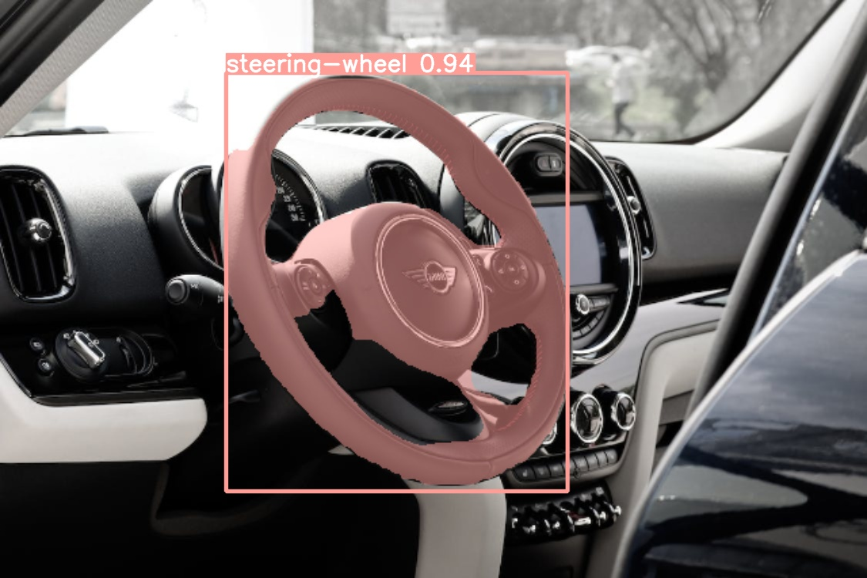
Overview Past
Yolo Semantic Segmentation
Detect every pixel that contains steering
May be useful for measurements
Higher error rate than detection
Re-training fixes error (Active Learning)
Misclassification

Slide 10
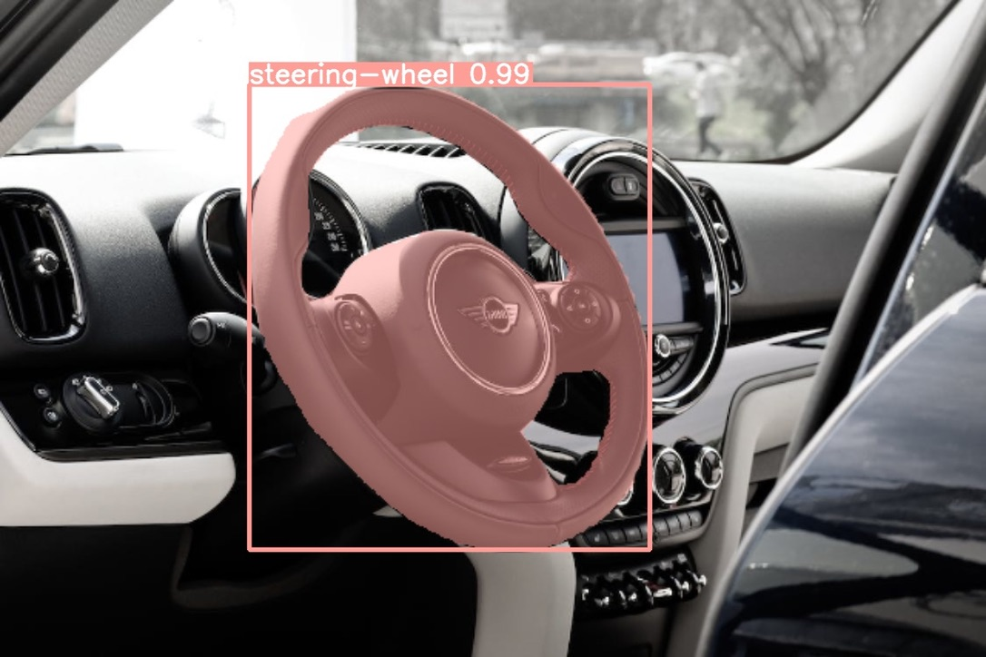
Overview Past
Yolo Semantic Segmentation II
After re-training
May be applicable to production environment
Test-bench fixed and static env
Manageable quantity of steering variations
!Risk of overfitting!

Slide 11
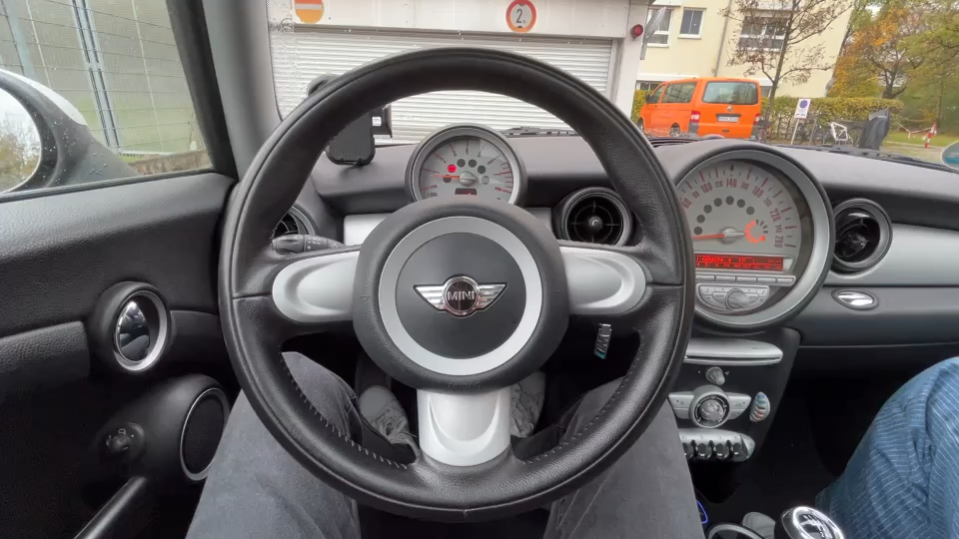
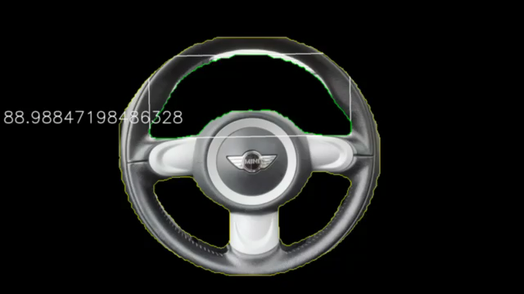
Overview Past
Angle Measurement in 2D
Angle is not converted!
Measurement in 2D image plane -> error through camera distortion etc.

Slide 12
Overview ToDo
What needs to be done?
Timeline
Define precision goals
Test-bench review
External camera view through driver window
Interieur camera Evaluation -> Processing / Measurement
LiDAR usage -> Processing / Detection of steering / Measurement
3D mapping of steering
3D measurements
Self-Calibration -> In-between measurements -> On-site with markers in environment

